Slide 1
Housing Price Prediction
By Deepak Kumar

Slide 2
Contents
Business Goal
Exploratory Data Analysis
Data Pre-Processing
Observations
Conclusion

Slide 3
Business Goal
We are required to model the price of houses with the available independent variables.
This model will then be used by the management to understand how exactly the prices vary with the variables.
They can accordingly manipulate the strategy of the firm and concentrate on areas that will yield high returns.
Further, the model will be a good way for the management to understand the pricing dynamics of a new market.
The goal of this project is to create a regression model that are able to accurately estimate the price of the house given the features

Slide 4
Exploratory Data Analysis
Data contains 1460 entries each having 81 variables.
Data contains Null values. We treated them using the domain knowledge and your own understanding.
Extensive EDA has to be performed to gain relationships of important variable and price.
Test data has 1459 entries each having 80 variables.
Data contains numerical as well as categorical variable.
Data is cleaned down further to have 1460 entries each having 74 variables.
Independent Variable is SalePrice.

Slide 5
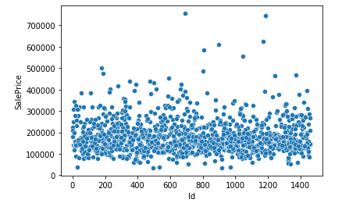
SalePrice- The response Variable SalePrice has no relation with ID, It doesn’t show any relation that of Id is higher, SalePrice will increase

Slide 6
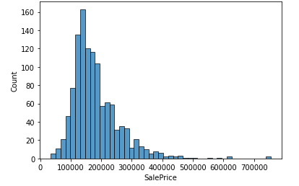
Distribution of SalePrice It mostly has the data with range between 100000 to 300000 and has few outliers and is rightly skewed

Slide 7
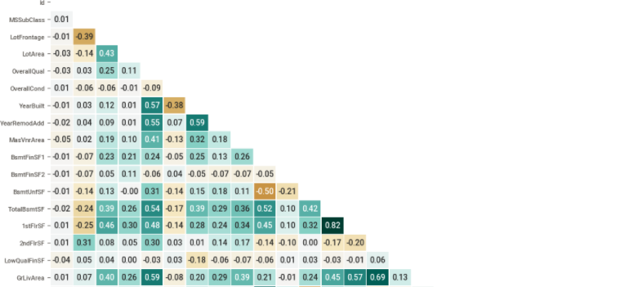
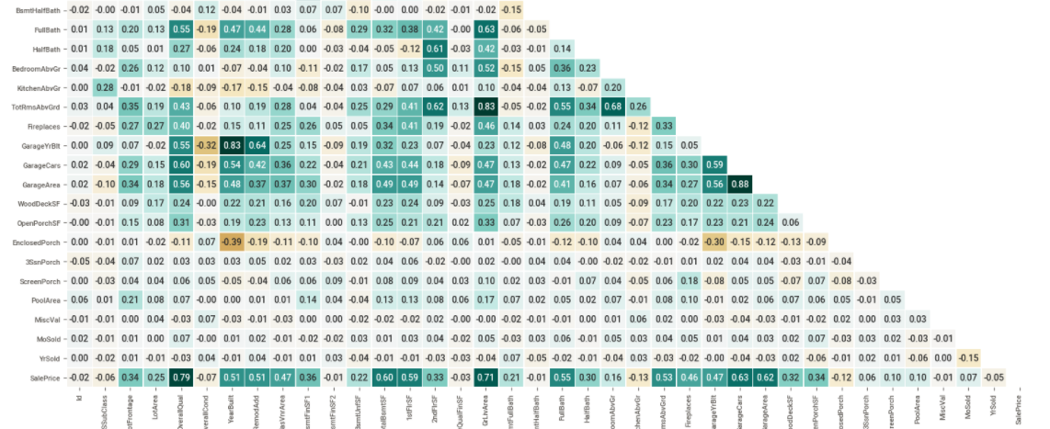
Correlations

Slide 8
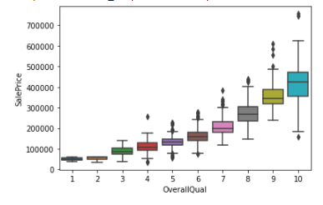
Relation between Quality and SalePrice

Slide 9
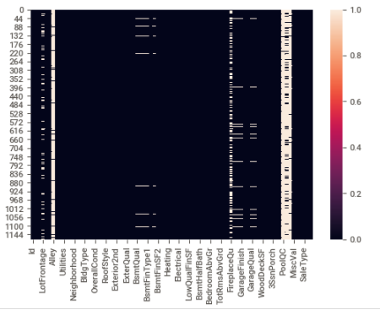
Missing Values

Slide 10
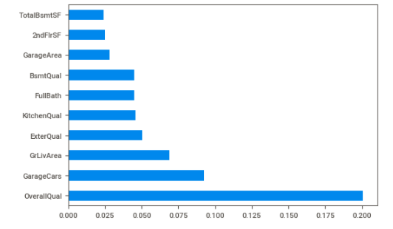
Tope 10 Features

Slide 11
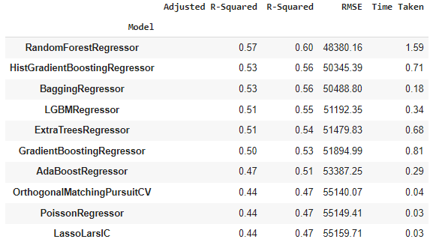
Lazy Test

Slide 12
Observations
In this study, our models are trained with 18-year of housing property data utilizing stochastic gradient descent (SGD) based support vector regression (SVM), random forest (RF) and gradient boosting machine (GBM). We have demonstrated that advanced machine learning algorithms can achieve very accurate prediction of property prices, as evaluated by the performance metrics.
First, our study has shown that advanced machine learning algorithms like SVM, RF and GBM, are promising tools for property researchers to use in housing price predictions. However, we must be cautious that these machine learning tools also have their own limitations. There are often many potential features for researchers to choose and include in the models so that a very careful feature selection is essential.
Second, many conventional estimation methods produce reasonably good estimates of the coefficients that unveil the relationship between output variable and predictor variables Based on these estimates, investigators can interpret the results and make policy recommendations.
Third, the computation of machine learning algorithms often takes much longer time than conventional methods such as hedonic pricing model. The choice of algorithm depends on consideration of a number of factors such as the size of the data set, computing power of the equipment, and the availability of waiting time for the results.

Slide 13
Conclusion
The application of machine learning in property research is still at an early stage.
We hope this study has moved a small step ahead in providing some methodological and empirical contributions to property appraisal, and presenting an alternative approach to the valuation of housing prices.
Future direction of research may consider incorporating additional property transaction data from a larger geographical location with more features, or analyzing other property types beyond housing development.
For the other model, the error prediction values are still large. Using different methods that match the time-series data will be used in the future research to obtain smaller error prediction values and using more data to get the better result..

Slide 14


